Slide 1

SPADE 1-part model
Estimating the habitual intake distribution of daily consumed food(components)

Slide 2


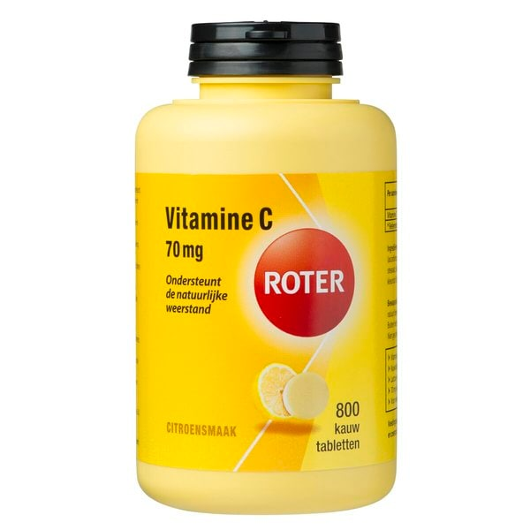
Goal SPADE 1-part model today
To assess the habitual intake of the variables which are daily consumed by (almost) everyone in the population
Example:
Vitamin C from foods Vitamin C from supplements

Slide 3
Getting started with SPADE
1
What happens in SPADE – Brief overview
2
Data requirements
3
How to work with SPADE – guided by an example
4
Output of SPADE
5
Additional options with SPADE

Slide 4

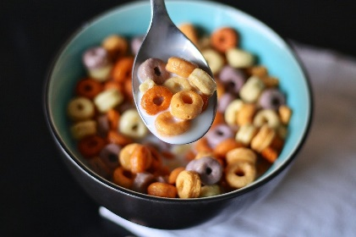
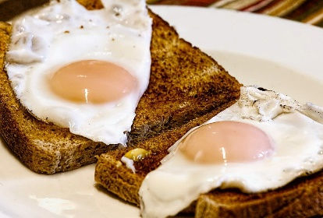
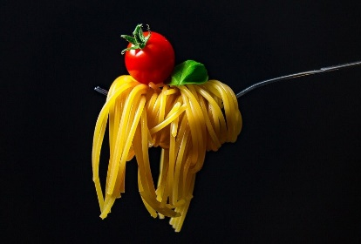
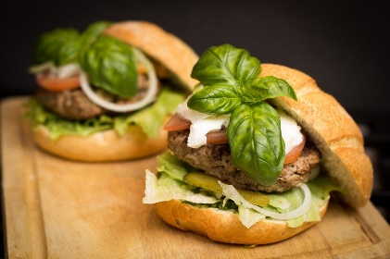
What happens in SPADE
Not the same everyday = within person variation
Day 1
Day 2
Habitual intake distribution of the total population
&
Not the same for every person = between person variation

Slide 5
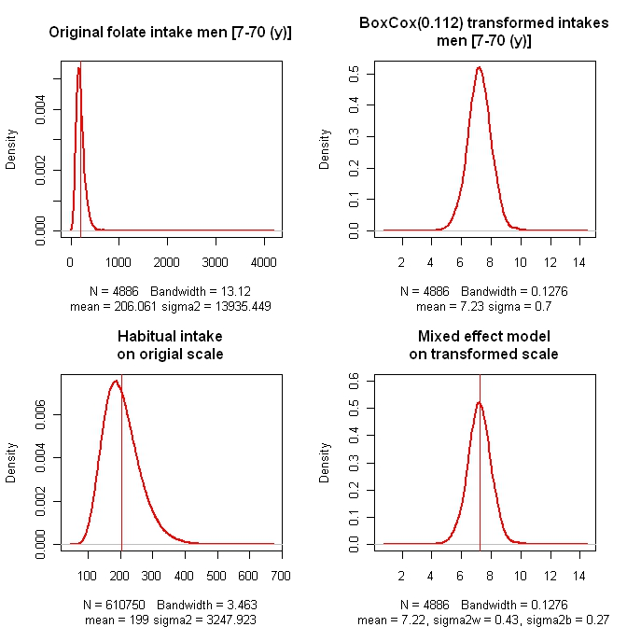

habitual intakes: main steps 1-part modelling
Transformation of intakes to obtain a symmetric distribution
Modelling σ^{2 →} $σ_{b}^{2}$+ $σ_{w}^{2}$
Back-transformation
1
3
Notes:
1. Transform (Box-Cox) the observed intakes to obtain a normal distribution on the transformed scale

Slide 6
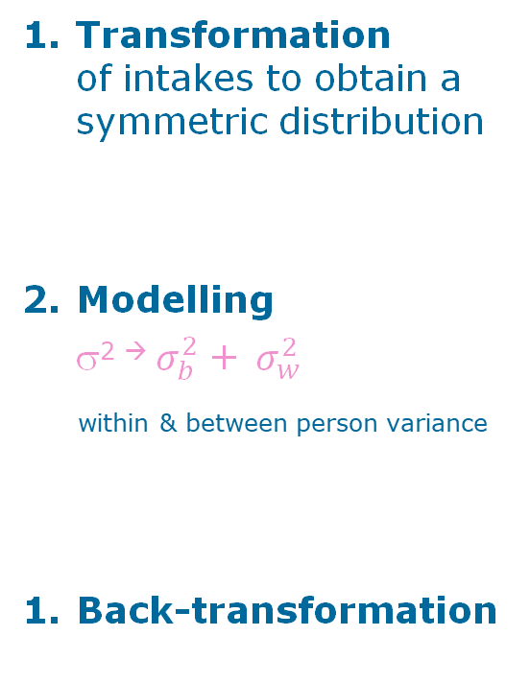
habitual intakes: main steps 1-part modelling
Transformation of intakes to obtain a symmetric distribution
Modelling σ^{2 →} $σ_{b}^{2}$+ $σ_{w}^{2}$
within & between person variance
Back-transformation
1
2
Notes:
2. Model the transformed intake as a function of age; estimate all model parameters, including the within- and between-person variances; and use these to obtain the shrunken distribution on the transformed scale

Slide 7
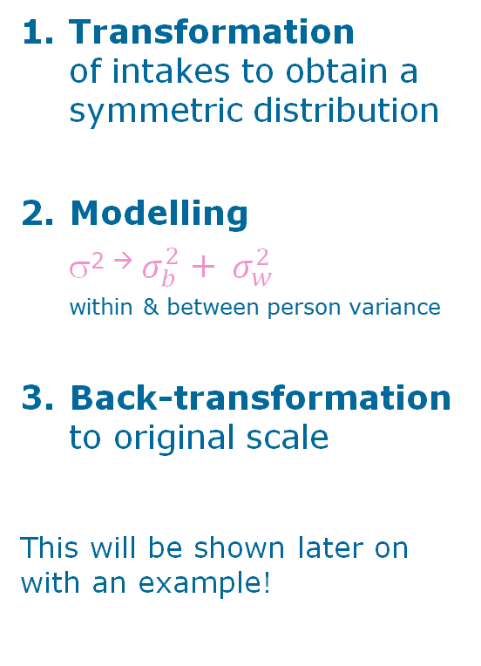
habitual intakes: main steps 1-part modelling
Transformation of intakes to obtain a symmetric distribution
Modelling σ^{2 →} $σ_{b}^{2}$+ $σ_{w}^{2}$ within & between person variance
Back-transformation to original scale
This will be shown later on with an example!
1
2
3
Notes:
3. Back-transform the distribution percentiles (per age unit) from the transformed scale to the original scale and eliminate the within-person variance

Slide 8
Data requirements
To use SPADE and calculate habitual intakes

Slide 9
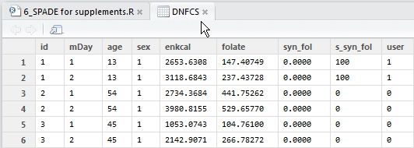
Food consumption dataset
Enough people with at least 2 positive intakes to estimate the between and within person variance
Rule of thumb: at least 50 persons
For each subject at least 1 observation, 1 amount for each compound per day. Subjects with m observation days have m rows in the data set
Compulsory variables: id / age / sex (sex=1 male; sex=2 female)

Slide 10
Getting started with SPADE

Slide 11
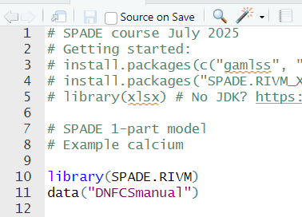
Assumed knowledge
Open packages
Import datasets

Slide 12
1-part model – most basic model
f.spade(frml.ia=ca ~ fp(age),
frml.if="no.if",
data=DNFCSmanual,
min.age=1,
max.age=79,
sex.label="female",
seed=29062025,
spade.output.path = “0_SPADE_output”
)
Nutrient of interest
No ‘intake frequency’
Food consumption data
Min age in model
Max age in model
Gender for which habitual intake will be estimated
Guarantees the reproducibility of the results, with the same settings and data
fractional polynomial as function of age

Slide 13
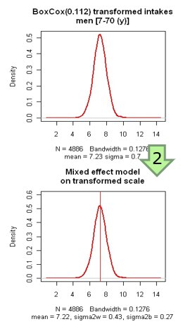
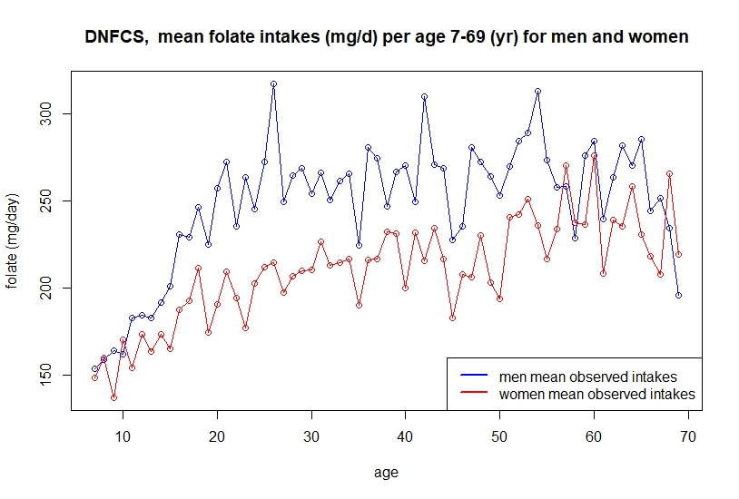
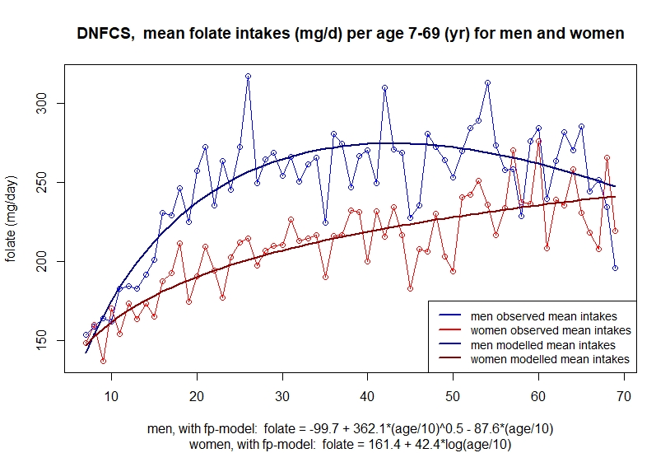
Fractional polynomial - intermezzo
Mean intake is depending on age.
So putting in a function of age for the mean will improve the model.
fp flexible and smooth, easy to fit and no intervention of user needed

Slide 14
Arguments ((required) to be defined by user)
Argument | Type | Description
frml.ia | formula | Define variable to model habitual intake (e.g. response) Age-dependent modeling: frml.ia=response ~fp(age) Age-independent modeling: frml.ia=response ~1
frml.if | string | For daily intakes: frml.if=“no.if”
data | data frame | Define name of dataset in R used in analysis (e.g. DNFCS) Data=DNFCSmanual
min.age | number | Define minimum age to be used in analysis (e.g. 1; not necessarily minimum age in dataset) min.age=1
max.age | number | Define minimum age to be used in analysis (e.g. 79; not necessarily minimum age in dataset) max.age=79
sex.label | string | Define gender to be used in analysis, 3 options: sex.label=“male” or sex.label=“men” sex.label=“female” or sex.label=“women” sex.label=“both” (be aware in dataset: sex=1 male; sex=2 female)
seed | number | A number to set the seed of the random generator. This variable guarantees the reproducibility of the results, with the same settings and data.
spade.output.path | string | Path to the folder where SPADE creates output folders

Slide 15
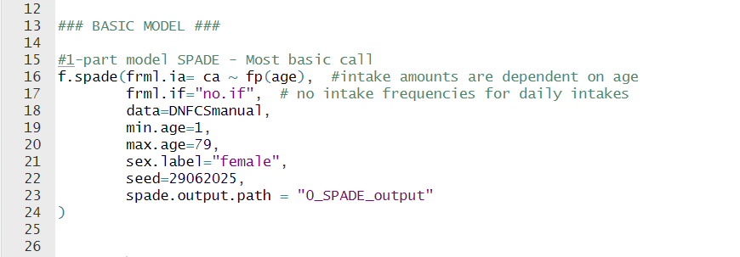
In R script

Slide 16
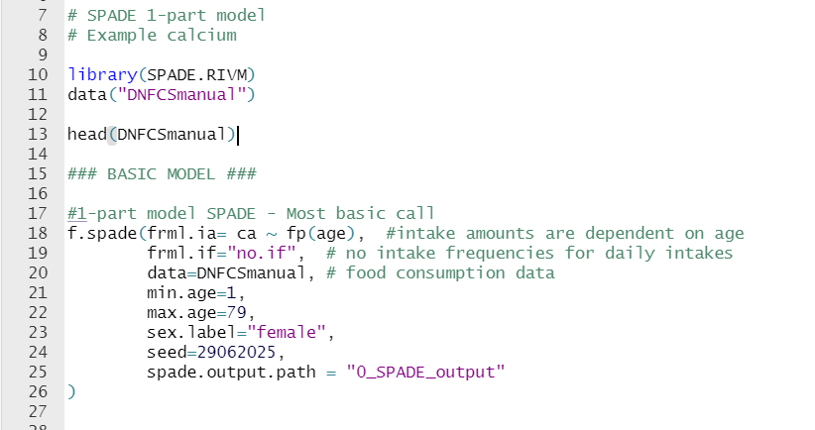
Exercise 1
Load the DNFCSmanual dataset in R Studio.
Follow the previous script, so:
Check the variables in DNFCSmanual
Run the 1-part model to obtain habitual calcium intakes for women aged 1-79 years old
Remember to define the output path!
Notes:
30 min

Slide 17
Output in console
Check your analysis!
1
2
3

Slide 18
1-part model – output in console - 1
Information about the data
SPADE.RIVM version : 4.1.52 (packaged on 2024-10-12)
Data used : DNFCSmanual (version )
f.spade:
Making a model for ca from DNFCSmanual women 1 - 79 ...
- only intake amount modelling
Number of observations per person
nr_obs nr_persons
1 1 79
2 2 1990
3 3 56
4 4 23
There are no zeros in the sample
Number of persons available for estimation of
the between and within person variances seems to be O.K. : 2069
Notes:
Screenshots updaten

Slide 19
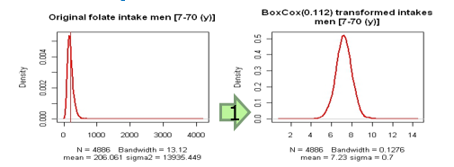
1-part model – output in console - 2
Lambda
======== Results modelling intake amounts ========
Fit of Box-Cox transformation parameter lambda
log.lik lambda LB UB
1 -15072 0.362 0.32 0.4
Box-Cox transformation:
optimal lambda between 0 and 1
λ=0 log transformation;
λ=1 no transformation
LB=95% CI lowerbound
UB=95% CI upperbound
Lambda should not be negative!
Rule of thumb:
lambda < -0.10, intake distribution very skewed, check data!

Slide 20
1-part model – output in console - 3
Within and between-person variance
Random effects:
Groups Name Variance Std.Dev.
id (Intercept) 11.69492 3.419783 Between-person variance
Residual 15.05978 3.880694 Within-person variance
Number of obs: 4319, groups: id, 2148 11.7+15.1 = 26.8 (variance error)
within-individual variance = 15.1
between-individual variance = 11.7
ratio var.inner/var.between for intake amounts = 1.29
Ratio should be not too small, and not too large
Small: small day-to-day variation in their intakes
Large: maybe some persons have very high variance over their survey days. Between person variance is almost zero, could be false
Rule of thumb: ratio within/between variance between 0.25 and 4

Slide 21
Habitual mean vs. observed mean
* * * Statistics of observed and habitual intakes * * *
(weighted) sample mean intake = 821.367
overall mean of habitual intakes = 820.326
difference of mean HI mean from (weighted) sample mean = -0.127 %
Mean observed & mean habitual are identical
Rule of thumb for 1-part model: difference of mean between -5% and 5%

Slide 22
1-part model – output in console - 1
spade output table for ca
AM P5 P10 P25 P50 P75 P90 P95
(0,79] 820 434 500 626 792 983 1179 1306
(0,1] 670 358 414 517 647 800 953 1053
(1,2] 676 364 419 519 651 804 967 1071
(2,3] 682 371 424 528 658 815 965 1066
(3,4] 687 374 429 528 664 818 970 1083
(4,5] 704 388 445 545 683 835 986 1107
(5,6] 702 384 440 543 680 838 996 1093 (0,79] = age-group 1-79 yr
….. (0,1] = age 1 yr
(78,79] 900 525 590 716 874 1056 1232 1365 (78,79] = age 79 yr
Confidence intervals: check first the plots and logbooks,
next use f.spade.bootstrap.
=====================================================================
The SPADE output is saved in
…/0_SPADE_OUTPUT Output path like we assigned in the script
- Diagnostic plots can be found in 1_plots
- Log files can be found in 2_logbooks
- Excel output tables can be found in 3_excel_tables
- The model and table R-binaries in 4_r_binaries
are saved for experts in R
=====================================================================

Slide 23
Exercise 2
Try to find the lambda, within- and between-person variance and habitual mean vs. observed mean in your output.
What is the habitual mean calcium intake of 51 year old women?
See if you can find the folders with the plots, logbooks, excel tables and binaries.

Slide 24
Answer exercise 2
spade output table for ca
AM P5 P10 P25 P50 P75 P90 P95
(0,79] 820 434 500 626 792 983 1179 1306
(0,1] 670 358 414 517 647 800 953 1053
(1,2] 676 364 419 519 651 804 967 1071
…
(49,50] 974 566 640 780 945 1143 1344 1471
(50,51] 977 591 652 793 939 1151 1339 1441
(51,52] 983 604 671 802 968 1150 1311 1418
(52,53] 995 598 666 790 971 1167 1366 1471

Slide 25
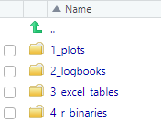
Where to find the output
Plots, logbooks, Excel/CSV tables and binaries

Slide 26
1-part model – output files
Output saved outside R to:
save space in memory and SPADE remains fast
be able to do many analyses at once
be able to study all output afterwards and to check model assumptions.

Slide 27
SPADE output
You can also define the directories where to save results
e.g. to organize results logically
to prevent overwriting results previous analyses
SPADE OUTPUT directory can be set by the user
SPADE.OUTPUT.PATH <-
“N:/Data/R/2025 SPADE Course/0_SPADE_OUTPUT"
Other directories than 0_SPADE_OUTPUT (e.g. R and 2025 SPADE Course)
should exist already and cannot be created by SPADE,
but can be created in Rstudio pane right down.

Slide 28
1-part model – output files
4 directories:
1_plots
Plots visualizing the data (spade_DNFCSmanual_ca_f_1_79.pdf)
2_logbooks
Output info (spade_DNFCSmanual_ca_f_1_79_logbook.txt)
Model info (spade_DNFCSmanual_ca_f_1_79_details.txt)
3_excel_tables
Results in excel format (spade_DNFCSmanual_ca_f_1_79.xlsx)
4_r_binaries
Model and table binary files

Slide 29
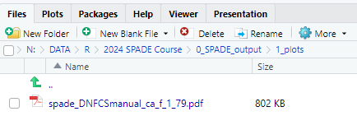
Output in plots
saved as .pdf

Slide 30
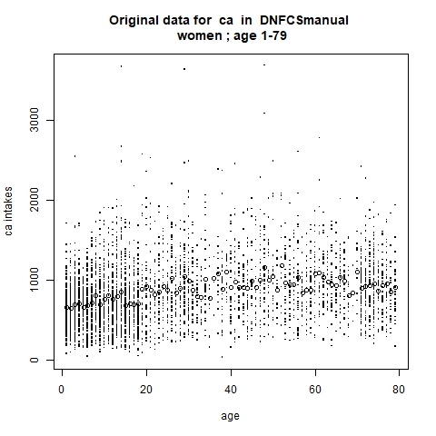
1-part model – plots - 3
Original data plotted against age
Knots = mean intake per age
High intakes in some ages clearly visible
Mean intake increased slightly with age, especially at younger ages

Slide 31
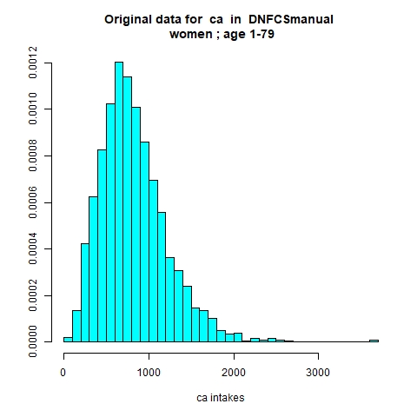
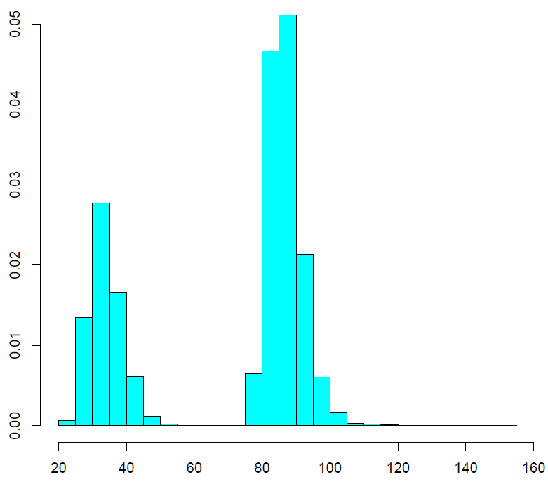
1-part model – plots - 1
Histogram of original observations
(2 per subject)
Data is skewed to the right
(largest intake is >3000 microgram)
Notes:
Check for multimodality

Slide 32
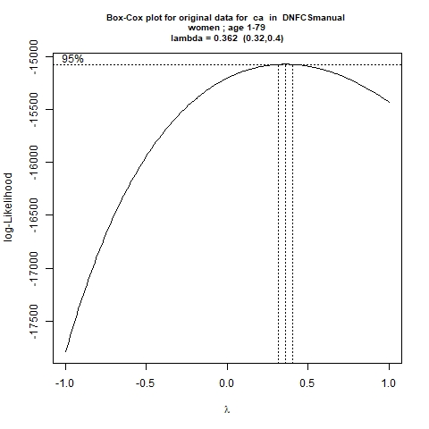
1-part model – plots - 2
Results of Box-Cox transformation
Lambda with max. likelihood = 0.268
Lower bound of 95% confidence interval
Upper bound of 95% confidence interval
Lambda=0 → log transformation
Lambda=1 → no transformation
Notes:
If lambda= negative value → lambda set at 0 → is this true??

Slide 33
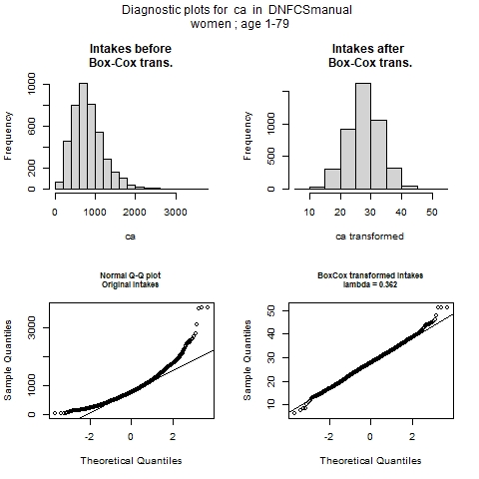
1-part model – plots - 4
The impact of the Box-Cox transformation
Left before transformation
Right after transformation
Transformed intakes are more or less
normally distributed:
QQ-plot straight line with some deviations at both ends (outliers?)

Slide 34
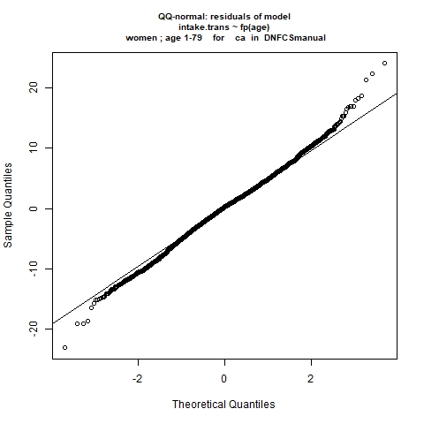
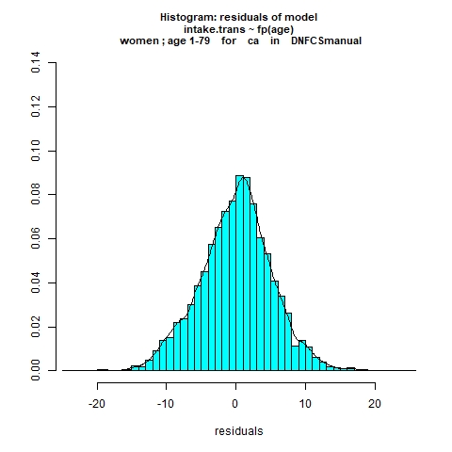
1-part model – plots - 5
Residuals = difference between transformed observed intakes and predicted intakes on transformed scale by the models
QQ-plot: if distribution is normal: straight line
Here some deviations at both ends
Histogram of the residuals:
(almost) normal distribution
Notes:
The QQ-plot of the residuals of the SPADE model should theoratically be normally distributed. This is checked by this QQ-plot. Most of the residuals are clearly on the straight line. At both tails, there are some deviations: at the lower tail, the lowest residuals are too low and at the upper tail, the residuals are too high. From this plot we conclude that the model assumptions don’t seem to be violated, and that we can use the output tables. When violated, this can indicate multimodality → intake from 2 sources

Slide 35
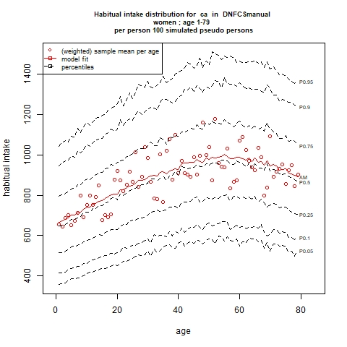
1-part model – plots - 6
The habitual intake distribution per age, showing only the requested percentiles (5th, 25th, 50th, 75th, 95th) and the mean (red line)
Red knots → (weighted) mean per age
these fluctuate → modeling as function of age
age unit can also be months, days etc.

Slide 36
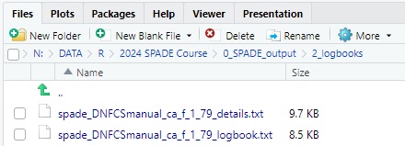
Output in logbooks
saved as .txt
5

Slide 37
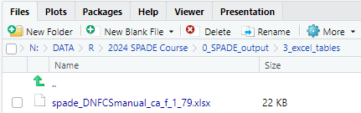
Output in tables
saved as .xlsx
5

Slide 38
Automatic output.name generation
In the directory of your R project SPADE output is saved in excel file directories.
Using automatic names:
Excel
spade_DNFCSmanual_ca_f_1_79.xlsx
Attention, if you change a function argument, which is involved in the automatic name generation, you have to use argument output.name in order the get a unique output name. If not, previous results will be overwritten.
Model
Dataset
‘nutrient’ name
Gender (f=female=2)
Min age (1) and max age (79)
User defined output name → output.name in script SPADE

Slide 39
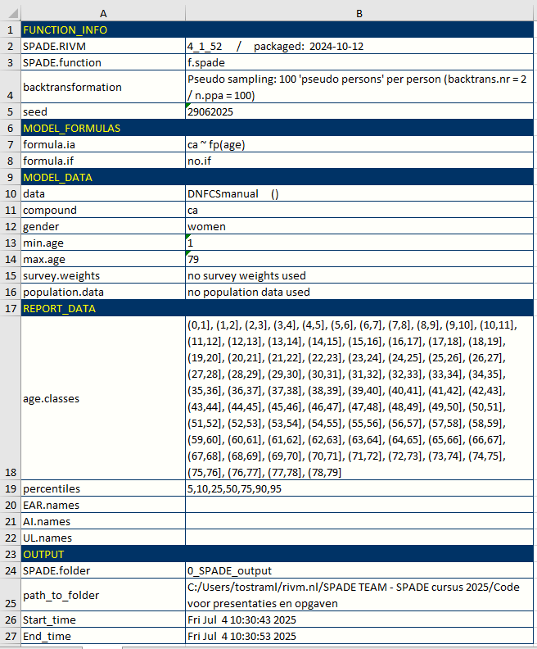

First sheet: Information about your analysis in SPADE

Slide 40
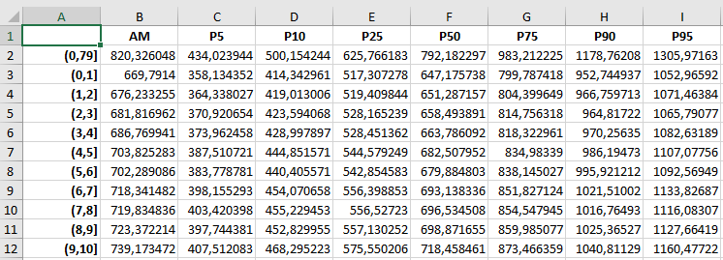
Second sheet: Habitual Intakes (first 11 rows)e output in tables

Slide 41
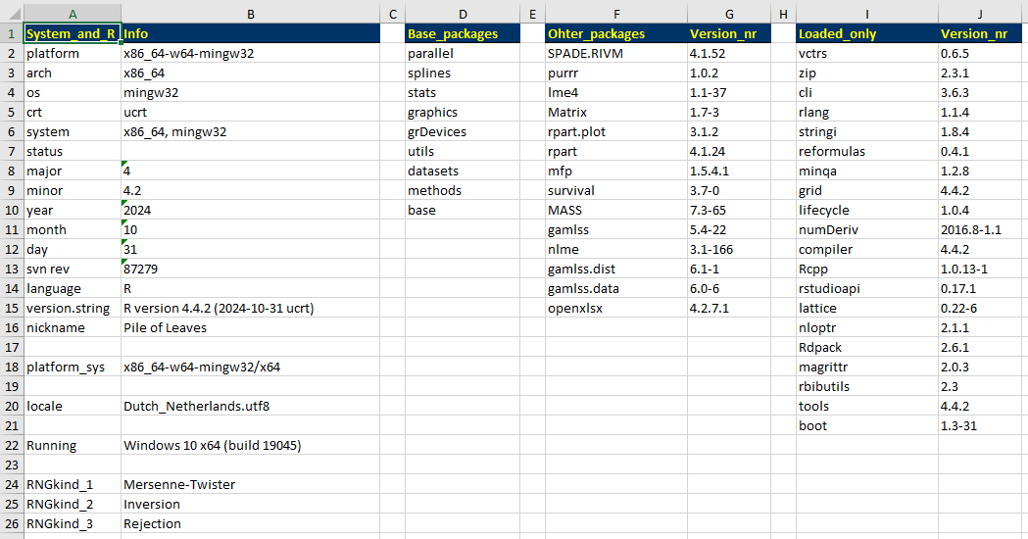
Third sheet: Session info

Slide 42
Exercise 3
Try to open the plot, logbooks and excel files
Compare the logbook.txt and the details.txt. What are the differences?
See the Excel file. Which version of SPADE was used in your analysis?
Again, try to find the habitual mean calcium intake of 51 year old women, but now in the Excel file. Is there a difference with the habitual intake from the console?

Slide 43
Answers exercise 3
Compare the logbook.txt and the details.txt. What are the differences?
Logbook.txt = same as output in console
Details.txt = additional information on number of observations per age, information on zeroes, information on fractional polynomial model, pseudo sample and backtransformation

Slide 44

Answers exercise 3
See the Excel file. Which version of SPADE was used in your analysis?
Again, try to find the habitual mean calcium intake of 51 year old women, but now in the Excel file. Is there a difference with the habitual intake from the console?
Not rounded, but 4 decimals

Slide 45
Additional options in SPADE

Slide 46
SPADE– additional options
function (frml.ia, frml.if, data, min.age, max.age, sex.label,
seed = NULL, lambda = NULL, weights.name = NULL, dt.pop = NULL,
n.ppa = 100, spade.output.path = SPADE.OUTPUT.PATH, output.name = NULL,
age.classes = NULL, prb = c(5, 10, 25, 50, 75, 90, 95)/100,
EAR.names = NULL, AI.names = NULL, UL.names = NULL, dgts = 3,
dgts.distr = 0, dgts.dri = 1, verbose = TRUE, plot.dev = 4,
colours.ok = TRUE, outlier.ok = FALSE, automatic.ok = TRUE,
backtrans.nr = 2, fun.name = "spade", subgroups.ok = FALSE,
bootstrap.ok = FALSE, boot3.ok = FALSE, boot.dt.name = NULL,
STOP_bpVAR = 1e-04, eps.prob = 1e-04, eps.norm = 1e-04, norms.ok = TRUE,
csv.output.path = NULL, ia.method = NULL)
Arguments in
Green → required to be defined by user
Blue → optional, possible to define by user
Red → not to define by user

Slide 47
Additional options Age classes and percentiles

Slide 48
Blue arguments (optional, possible to define by user) - 1
Argument | Type | Description
age.classes | vector | Define age-classes to report output (e.g. 7-8 yr, 9-13 yr, 14-18 yr) age.classes = c(6, 8, 13, 18)
prb | Number vector | prb stands for probs, the probabilities of the reported quantiles. Default prb = c(0.05, 0.1, 0.25, 0.5, 0.75, 0.9, 0.95) Defines the percentiles of the habitual intake distribution to be reported.

Slide 49
Age classes
By default, no age classes.
Sometimes interested in habitual intake distribution shown in different age categories
For example: 1-3 y, 4-6 y, 7-10 y, 11-13 y, 14-17 y, 18-30 y, 31-50 y and 50-79 y
age.classes = c(0, 3, 6, 10, 13, 17, 30, 50, 79)

Slide 50
Percentiles
By default SPADE provides results:
Mean and percentiles 5, 10, 25, 50, 75, 90 and 95
to have simple and small tables.
This can be changed by the user adding the prb argument to the script and changing the numbers
prb = c(0.05, 0.25, 0.5, 0.75, 0.95)
or
prb = c(1,5,10,25,50,75,90,95,99)/100
or
prb = seq(from = 0.01, to = 0.99, by = 0.01)
or shorter
prb = (1:99)/100

Slide 51
Additional options Survey weights

Slide 52
Survey weights 1
In ideal situation,
study sample is miniature of population it came from
…and representative for the variables measured in the study
In practice,
groups may be under- or overrepresented
… and conclusions based on study population may not be representative
Weighing is a common procedure to correct results for deviations of sample population from original population

Slide 53
Survey weights 2
Assumption: survey weights are already calculated
Only necessary if you have a national survey, not necessary if you want to draw conclusions about the study population
With the survey weights:
Underrepresented groups get a higher weight
Overrepresented groups get a lower weight
Notes:
MO: er is ook een cheat sheet over de gewichten toch? Evt hier nog naar verwijzen

Slide 54
Survey weights 3 Blue arguments (optional, possible to define by user) - 2
Argument | Type | Description
weights.name | string | Define survey weigths (e.g. w_demog_season_wk_wknd) weights.name=“w_demog_season_wk_wknd”
Survey weights is a variable in the same dataset as the ‘nutrient’, with a name you like
Survey weights are person-specific; so same weight for all survey days
For computational convenienc: survey weights should be normalized,
data[, "weights"] <- data[, "weights"] / mean(data[, "weights"] ) so that the sum of all weights is equal to the number of observations

Slide 55
Additional options Output name

Slide 56
Output name
Recommended to use when you changed additional options (for example age classes or use of survey weights) and want to compare this to an output with other additional options (for example different age classes or no survey weight)
Output name can be (almost) any name you want, for example:
output.name = “DNFCSmanual_ca_f_1_79_agecl”
output.name = “calcium_women_weights”
output.name = “test”
Etc.
Check appendix B.1 of the manual for the conditions (no dots for example)
With the same data set and same model, but with extra options, results will be overwritten if you don’t use argument output.name!

Slide 57
Additional options DRIs

Slide 58
Dietary reference values
(estimated) average requirement (EAR)
Adequate intake (AI)
Tolerable upper intake level (UL)

Slide 59
How to evaluate dietary intake of group - I
EAR-cut point method (available in SPADE) Carriquiry et al. Pub Health Nutr 1999
% <EAR is good estimate of % inadequate in population
…but only under some conditions/assumptions:
- intake & requirement independent
- requirement distribution = symmetric
- variance requirement << variance intake
Other method (Beaton’s Full probability method) available upon request
energy
iron

Slide 60
How to evaluate dietary intake of group - II
Qualitative comparison with AI (~available in SPADE)
No average requirement (EAR) available
Median ≥ AI -> low risk of inadequate intake in population
Median < AI -> no statement possible, additional research required

Slide 61
How to evaluate dietary intake of group - III
Comparison with UL (available in SPADE)
Generally, proportion with habitual intake > UL reported
… however, intake > UL ≠ unsafe
Intake < UL = likely to pose no risk
Perhaps better to start reporting %<UL Carriquiry et al. 2006 J. Nutr

Slide 62
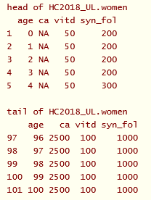
Evaluate dietary intake of group - SPADE
Additional datasets
Separate for each EAR (2x), AI (1x), UL(2x)
Cut-off points by age-unit (row): all ages in food consumption survey should be present (e.g. use 1-100, not necessary all a value)
Gender in separate datasets
Variable names same as in dataset with food consumption data

Slide 63
Evaluate dietary intake of group - SPADE
Additional datasets
Separate for each EAR (2x), AI (1x), UL(2x)
Cut-off points by age-unit (row): all ages in food consumption survey should be present (e.g. use 1-100, not necessary all a value)
Gender in separate datasets
Variable names same as in dataset with food consumption data

Slide 64
Evaluate dietary intake of group - SPADE
Additional SPADE-script (page 56 manual)

Slide 65
Evaluate dietary intake of group - SPADE
f.spade( frml.ia = ca ~ fp(age), frml.if = "no.if", data = DNFCSmanual, min.age = 1, max.age = 79, sex.label = "female", age.classes = c(0,8,13,17,30,50,79), weights.name = "w_demog_season_wk_wknd", prb = c(0.05, 0.95), EAR.names = c("HC2018_EAR.women" ), AI.names = "HC2018_AI.women", UL.names = c("HC2018_UL.women"), output.name = "DNFCSmanual_ca_f_1_79_DRI", seed = 29062020)
Additional SPADE-script
(page 56 manual)

Slide 66
SPADE-output
* * * Statistics of observed and habitual intakes * * * (weighted) sample mean intake = 900.084 overall mean of habitual intakes = 889.604 difference of mean HI mean from (weighted) sample mean = -1.164 % spade output table for ca
 | AM | P5 | P95 |  | EAR1 | EAR1.p | AI | AI.p | UL1 | UL1.p
(0,79] | 890 | 474 | 1399 |  | NA | NA | NA | NA | NA | NA
(0,8] | 695 | 361 | 1103 |  | NA | NA | 500 | 2 | NA | NA
(8,13] | 745 | 400 | 1179 |  | NA | NA | 1100 | 0 | NA | NA
(13,17] | 777 | 421 | 1229 |  | NA | NA | 1100 | 0 | NA | NA
(17,30] | 850 | 468 | 1319 |  | 860 | 46.5 | NA | NA | 2500 | 0
(30,50] | 945 | 534 | 1446 |  | 750 | 25.8 | NA | NA | 2500 | 0
(50,79] | 953 | 541 | 1461 |  | NA | NA | 1100 | 0 | 2500 | 0

Slide 67
SPADE-output
* * * Statistics of observed and habitual intakes * * * (weighted) sample mean intake = 900.084 overall mean of habitual intakes = 889.604 difference of mean HI mean from (weighted) sample mean = -1.164 % spade output table for ca
%< cut point (EAR1)
No EAR → NA
(0,79] not all EAR → NA
NA= not available
 | AM | P5 | P95 |  | EAR1 | EAR1.p | AI | AI.p | UL1 | UL1.p
(0,79] | 890 | 474 | 1399 |  | NA | NA | NA | NA | NA | NA
(0,8] | 695 | 361 | 1103 |  | NA | NA | 500 | 2 | NA | NA
(8,13] | 745 | 400 | 1179 |  | NA | NA | 1100 | 0 | NA | NA
(13,17] | 777 | 421 | 1229 |  | NA | NA | 1100 | 0 | NA | NA
(17,30] | 850 | 468 | 1319 |  | 860 | 46.5 | NA | NA | 2500 | 0
(30,50] | 945 | 534 | 1446 |  | 750 | 25.8 | NA | NA | 2500 | 0
(50,79] | 953 | 541 | 1461 |  | NA | NA | 1100 | 0 | 2500 | 0

Slide 68
SPADE-output
* * * Statistics of observed and habitual intakes * * * (weighted) sample mean intake = 900.084 overall mean of habitual intakes = 889.604 difference of mean HI mean from (weighted) sample mean = -1.164 % spade output table for ca
%> cut point (UL1)
No UL → NA
(0,79] not all UL → NA
NA= not available
 | AM | P5 | P95 |  | EAR1 | EAR1.p | AI | AI.p | UL1 | UL1.p
(0,79] | 890 | 474 | 1399 |  | NA | NA | NA | NA | NA | NA
(0,8] | 695 | 361 | 1103 |  | NA | NA | 500 | 2 | NA | NA
(8,13] | 745 | 400 | 1179 |  | NA | NA | 1100 | 0 | NA | NA
(13,17] | 777 | 421 | 1229 |  | NA | NA | 1100 | 0 | NA | NA
(17,30] | 850 | 468 | 1319 |  | 860 | 46.5 | NA | NA | 2500 | 0
(30,50] | 945 | 534 | 1446 |  | 750 | 25.8 | NA | NA | 2500 | 0
(50,79] | 953 | 541 | 1461 |  | NA | NA | 1100 | 0 | 2500 | 0

Slide 69
SPADE-output
* * * Statistics of observed and habitual intakes * * * (weighted) sample mean intake = 900.084 overall mean of habitual intakes = 889.604 difference of mean HI mean from (weighted) sample mean = -1.164 % spade output table for ca
Median intake ≥ AI → 1
Median intake < AI → 0
Within age class different results per age unit → 2
No AI → NA
(0,79] not all AI → NA
NA= not available
 | AM | P5 | P95 |  | EAR1 | EAR1.p | AI | AI.p | UL1 | UL1.p
(0,79] | 890 | 474 | 1399 |  | NA | NA | NA | NA | NA | NA
(0,8] | 695 | 361 | 1103 |  | NA | NA | 500 | 2 | NA | NA
(8,13] | 745 | 400 | 1179 |  | NA | NA | 1100 | 0 | NA | NA
(13,17] | 777 | 421 | 1229 |  | NA | NA | 1100 | 0 | NA | NA
(17,30] | 850 | 468 | 1319 |  | 860 | 46.5 | NA | NA | 2500 | 0
(30,50] | 945 | 534 | 1446 |  | 750 | 25.8 | NA | NA | 2500 | 0
(50,79] | 953 | 541 | 1461 |  | NA | NA | 1100 | 0 | 2500 | 0

Slide 70
Exercise 4
seed = 29062020
a) What proportion of men (30-40 yr) had a weighted habitual calcium intake above the UL (i.e. 2500 µg/d)? – use age- dependent modelling Hint: The UL information is in the file "HC2018_UL.men". To load it in, type: data(HC2018_UL.men)
b) What is the weighted habitual calcium intake for girls 1-9 and 10-17 yr (10th, 50th and 90th percentile) and what is the result of the comparison with the AI (i.e. 500-1100 µg/d) – use age dependent modelling?
Hint: The AI information is in the file "HC2018_AI.women". To load it in, type: data(HC2018_AI.women)
c) What is the weighted habitual calcium intake for men 30 yr (median, 25th and 75th percentile) and proportion with intake below the EAR – compare the results of age-dependent and not age-dependent modelling? Check the plots and logbooks of the analysis. What do the diagnostics tell you?

Slide 71
Results exercise 4a
a) What proportion of men (30-40 yr) had a weighted habitual calcium intake above the UL (i.e. 2500 µg/d)? – use age- dependent modelling
f.spade(
frml.ia = ca ~ fp(age),
frml.if = "no.if",
data = DNFCSmanual,
min.age = 1,
max.age = 79,
sex.label = "male",
age.classes = c(29,40),
weights.name = "w_demog_season_wk_wknd",
prb = c(0.25, 0.50, 0.75),
UL.names = c("HC2018_UL.men"),
output.name = "DNFCSmanual_ca_m_30-40_UL",
seed = 29062020)
0.14% → 0%

Slide 72
Results exercise 4b
b) What is the weighted habitual calcium intake for girls 1-9 and 10- 17 yr (10th, 50th and 90th percentile) and what is the result of the comparison with the AI (i.e. 500-1100 µg/d) – use age dependent modelling?
 | mean | P10 | median | P90 | Evaluation with AI
Girls 1-9 yr. (0,9] | 694 | 419 | 669 | 1003 | 2
Girls 10-17 yr. (9-17] | 767 | 475 | 741 | 1096 | 0
10-17 yrs → median < AI → no statement on adequacy possible, additional research needed

Slide 73
Results exercise 4b
b) What is the weighted habitual calcium intake for girls 1-9 and 10- 17 yr (10th, 50th and 90th percentile) and what is the result of the comparison with the AI (i.e. 500-1100 µg/d) – use age dependent modelling?
age | AI | median | Evaluation with AI
1 | 500 | 633 | 1
2 | 500 | 642 | 1
3 | 500 | 653 | 1
4 | 700 | 653 | 0
5 | 700 | 671 | 0
6 | 700 | 676 | 0
7 | 700 | 694 | 0
8 | 700 | 690 | 0
9 | 1100 | 701 | 0
 | Evaluation with AI
Girls 1-9 yr. (0,9] | 2
Girls 10-17 yr. (9-17] | 0
Check: spade_DNFCSmanual_ca_f_girls_AI_AI2

Slide 74
Results exercise 4b
b) What is the weighted habitual calcium intake for girls 1-9 and 10- 17 yr (10th, 50th and 90th percentile) and what is the result of the comparison with the AI (i.e. 500-1100 µg/d) – use age dependent modelling?
age | AI | median | Evaluation with AI
1 | 500 | 646 | 1
2 | 500 | 633 | 1
3 | 500 | 664 | 1
4 | 700 | 676 | 0
5 | 700 | 678 | 0
6 | 700 | 685 | 0
7 | 700 | 692 | 0
8 | 700 | 698 | 0
9 | 1100 | 703 | 0
Low risk on inadequate intakes
 | Evaluation with AI
Girls 1-9 yr. (0,9] | 2
Girls 10-17 yr. (9-17] | 0
Check: spade_DNFCSmanual_ca_f_girls_AI_AI2

Slide 75
Results exercise 4b
b) What is the weighted habitual calcium intake for girls 1-9 and 10- 17 yr (10th, 50th and 90th percentile) and what is the result of the comparison with the AI (i.e. 500-1100 µg/d) – use age dependent modelling?
age | AI | median | Evaluation with AI
1 | 500 | 646 | 1
2 | 500 | 633 | 1
3 | 500 | 664 | 1
4 | 700 | 676 | 0
5 | 700 | 678 | 0
6 | 700 | 685 | 0
7 | 700 | 692 | 0
8 | 700 | 698 | 0
9 | 1100 | 703 | 0
 | Evaluation with AI
Girls 1-9 yr. (0,9] | 2
Girls 10-17 yr. (9-17] | 0
No statement possible, additional research needed
Check: spade_DNFCSmanual_ca_f_girls_AI_AI2

Slide 76
Results exercise 4b
b) What is the weighted habitual calcium intake for girls 1-9 and 10- 17 yr (10th, 50th and 90th percentile) and what is the result of the comparison with the AI (i.e. 500-1100 µg/d) – use age dependent modelling?
Recommended to study the age groups for which the DRI is established:
 | Mean | P10 | median | P90 | AI | Evaluation with AI
Girls 1-3 yr. (0,3] | 667 | 398 | 643 | 972 | 500 | 1
Girls 4-8 yr. (3-8] | 703 | 425 | 677 | 1014 | 700 | 0
Girls 9-17 yr (8-17] | 761 | 472 | 736 | 1089 | 1100 | 0

Slide 77
Results exercise 4c seed = 29062020
c) Script age-dependent & age independent
Age-dependent
f.spade(
frml.ia = ca ~ fp(age),
frml.if = "no.if",
data = DNFCSmanual,
min.age = 1,
max.age = 79,
sex.label = "male",
age.classes = c(29,30,31),
weights.name = "w_demog_season_wk_wknd",
prb = c(0.25, 0.50, 0.75),
EAR.names = c("HC2018_EAR.men"),
output.name = "DNFCSmanual_ca_m_30_AD",
seed = 29062020)
Age independent
f.spade(
frml.ia = ca ~ 1,
frml.if = "no.if",
data = DNFCSmanual,
min.age = 1,
max.age = 79,
sex.label = "male",
age.classes = c(29,30,31),
weights.name = "w_demog_season_wk_wknd",
prb = c(0.25, 0.50, 0.75),
EAR.names = c("HC2018_EAR.men"),
output.name = "DNFCSmanual_ca_m_30_AID",
seed = 29062020)

Slide 78
Results exercise 4c (manual chapter 10)
seed = 29062020
Habitual calcium intake men 30 yr and proportion < EAR
 | mean | P25 | median | P75 | < EAR
Age dependent | 1067 | 812 | 1024 | 1278 | 18.8%
Age independent | 1031 | 769 | 984 | 1244 | 22.8%

Slide 79
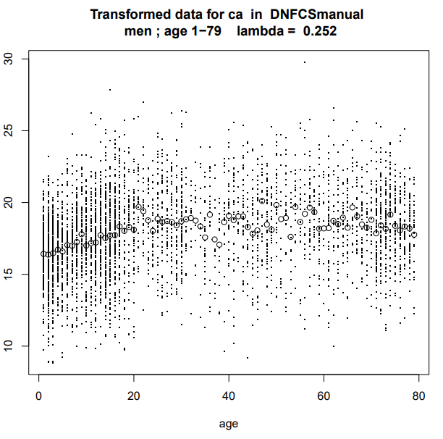
Results exercise 4c (manual chapter 10)
seed = 29062020
Habitual calcium intake men 30 yr and proportion < EAR
 | mean | P25 | median | P75 | < EAR
Age dependent | 1067 | 818 | 1018 | 1279 | 18.8%
Age independent | 1031 | 776 | 978 | 1245 | 22.8%

Slide 80
Interpretation – be aware I
Age-category dietary reference value versus consumption data
DRV’s are set in age-categories.
SPADE compares consumption in age units with DRV’s and combines results in age-categories.
What if, you have consumption data of 2-3 yr. olds and EAR (or UL) is set for 1-3 yr. old?

Slide 81
Interpretation – be aware I.a
What if, you have consumption data of 2-3 yr. olds and EAR (or UL) is set for 1-3 yr. old?
DRV based on average body weight 1-3 yr. (e.g. 20 kg)
1 year old (e.g. 10 kg) less weight than 3 yr old (e.g. 30 kg)
DRV 1-3 yr → e.g. 50 mg based on average of 20 kg →
overestimate 1 yr old (36.3 mg*), underestimate 3 yr old (62.5 mg)
%<EAR or >UL not valid if consumption data not for age-category DRV
* =25 + 1.25*BW

Slide 82
Interpretation – be aware II
Age-category dietary reference value versus consumption data
AI is set in age-categories.
SPADE compares median consumption in age units with AI. If results is equal in age-group SPADE returns 0 (<) or 1 (≥), if not then a 2 (< & ≥).
What if, you have consumption data of 19-30 yr. olds and AI set for 19-30 yr. olds and SPADE returns 2? Ages 19, 20, 21, 22 year have median intake < AI, all other ages have median intake > AI.

Slide 83
Interpretation – be aware II.a
What if, you have consumption data of 19-30 yr. olds and AI set for 19-30 yr. olds and SPADE returns 2? Ages 19, 20, 21, 22 year have median intake < AI, all other ages have median intake > AI.
AI is set for specific age-category
Compare habitual median intake of that age-category with AI, this will give you the overall conclusion.
On list for future adjustment of SPADE

Slide 84
Summary
SPADE 1-part model: habitual intake of intake variables which are daily consumed by (almost) everyone in the population
Transformation, modelling and back transformation for:
Distribution dependent of age
Elimination of within person variance
id, sex and age are essential
Check your output and plots!
Habitual intakes can be found in excel files
Additional options for age classes, percentiles and survey weights

Slide 85
Exercise 5
Recalculate the basic script for calcium, but:
Can you change the age classes in 1-13, 14-17, 18-50 and 51-79 yrs?
Calculate in addition to the standard percentiles also the first and 99th percentile

Slide 86
Exercise 5
# 1-part model SPADE - with age classes and percentiles
f.spade(
frml.ia = ca ~ fp(age),
frml.if = "no.if",
data = DNFCSmanual,
min.age = 1,
max.age = 79,
sex.label = "female",
age.classes = c(0, 13, 17, 50, 79),
prb = c(1, 5, 10, 25, 50, 75, 90, 95, 99)/100,
seed = 29062025,
output.name = "spade_DNFCSmanual_ca_f_1_79_agecl",
spade.output.path = "0_SPADE_output"
)
# Since we work in “…/", the output # will come in “…/0_SPADE_output/"

Slide 87
1-part model – output in console – age and percentiles
spade output table for ca
AM P1 P5 P10 P25 P50 P75 P90 P95 P99
(0,79] 820 325 434 500 626 792 983 1179 1306 1562
(0,13] 706 289 384 440 545 683 841 1003 1107 1331
(13,17] 777 332 433 494 608 753 919 1090 1199 1421
(17,50] 890 391 504 573 701 866 1051 1240 1365 1615
(50,79] 952 434 552 624 761 928 1119 1312 1436 1686
Output only presented in age-groups as defined: 9-13, 14-17 and 18-30 yr
Default overall age group 1-79 yr
Percentiles P1 and P99 are also shown
Did you keep the min.age and max.age on 1 and 79 y, respectively?
Did you use output.name to compare the results to the results from basic script?
Do you see the row with all the intakes ([0,79]) remained the same compared to the one of the basic script?

Slide 88
Exercise 6
Run the same model, while adding the survey weights (w_demog_season_wk_wknd). Compare the results with excercise 5. Don’t forget to change the output name to be able to compare results

Slide 89
Exercise 6
# Excercise 5
# 1-part model SPADE-
# with age classes, percentiles, survey weights
f.spade(
frml.ia = ca ~ fp(age),
frml.if = "no.if",
data = DNFCSmanual,
min.age = 1,
max.age = 79,
sex.label = "female",
weights.name = "w_demog_season_wk_wknd",
age.classes = c(0, 13, 17, 50, 79),
prb = c(1, 5, 10, 25, 50, 75, 90, 95, 99)/100,
seed = 29062025,
output.name = "spade_DNFCSmanual_ca_f_1_79_weight",
spade.output.path = "0_SPADE_output"
)

Slide 90
1-part model – output in console – weight
========================================
===== For extra info about model =====
========================================
See file
spade_DNFCSmanual_ca_f_1_79_weight_details.txt
Model for intake frequency: "no.if"
Survey weights (in column): w_demog_season_wk_wknd in DNFCSmanual
Scaled survey weights : w_demog_season_wk_wknd
with sum weights = 4340.98658
Attention: weights present, the standard errors of the fitted models are
not valid use e.g. f.spade.bootstrap
Info on use of survey weights
* * * Statistics of observed and habitual intakes * * *
(weighted) sample mean intake = 900.084
overall mean of habitual intakes = 889.672
difference of mean HI mean from (weighted) sample mean = -1.157 %
also weighted mean of observed intake is presented

Slide 91
1-part model – output in console – weight
spade output table for ca
AM P1 P5 P10 P25 P50 P75 P90 P95 P99
(0,79] 890 355 475 548 686 863 1062 1266 1399 1668
(0,13] 715 279 376 434 545 690 856 1027 1139 1375
(13,17] 786 331 427 488 607 763 937 1114 1230 1477
(17,50] 906 385 505 575 708 879 1074 1272 1402 1666
(50,79] 958 423 545 618 757 931 1129 1333 1465 1733
Output only presented in age-groups as defined: 9-13, 14-17 and 18-30 yr
Default overall age group 1-79 yr
Results different from previous un-weigthed analysis

Slide 92
Exercise 7
# 1-part model SPADE- vitd
# with age classes, percentiles, survey weights
f.spade(
frml.ia = vitd ~ fp(age),
frml.if = "no.if",
data = DNFCSmanual,
min.age = 1,
max.age = 79,
sex.label = "female",
weights.name = "w_demog_season_wk_wknd",
age.classes = c(0, 3, 6, 10, 14, 17, 50, 79),
prb = c(2.5, 5, 10, 25, 50, 75, 90, 95, 97.5)/100,
seed = 29062025,
output.name = "spade_DNFCSmanual_vitd_f_1_79_weight",
spade.output.path = "0_SPADE_output/"
)

Slide 93
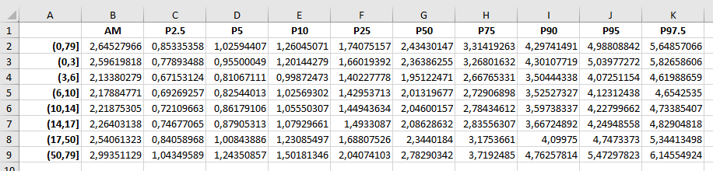
Vitamin D
spade output table for vitd
AM P2.5 P5 P10 P25 P50 P75 P90 P95 P97.5
(0,79] 3 1 1 1 2 2 3 4 5 6
(0,3] 3 1 1 1 2 2 3 4 5 6
(3,6] 2 1 1 1 1 2 3 4 4 5
(6,10] 2 1 1 1 1 2 3 4 4 5
(10,14] 2 1 1 1 1 2 3 4 4 5
(14,17] 2 1 1 1 1 2 3 4 4 5
(17,50] 3 1 1 1 2 2 3 4 5 5
(50,79] 3 1 1 2 2 3 4 5 5 6
Median intake is the same for each age class, except for the oldest group. However, check the excel output for output with more decimals, to observe some differences.

